Slide 1

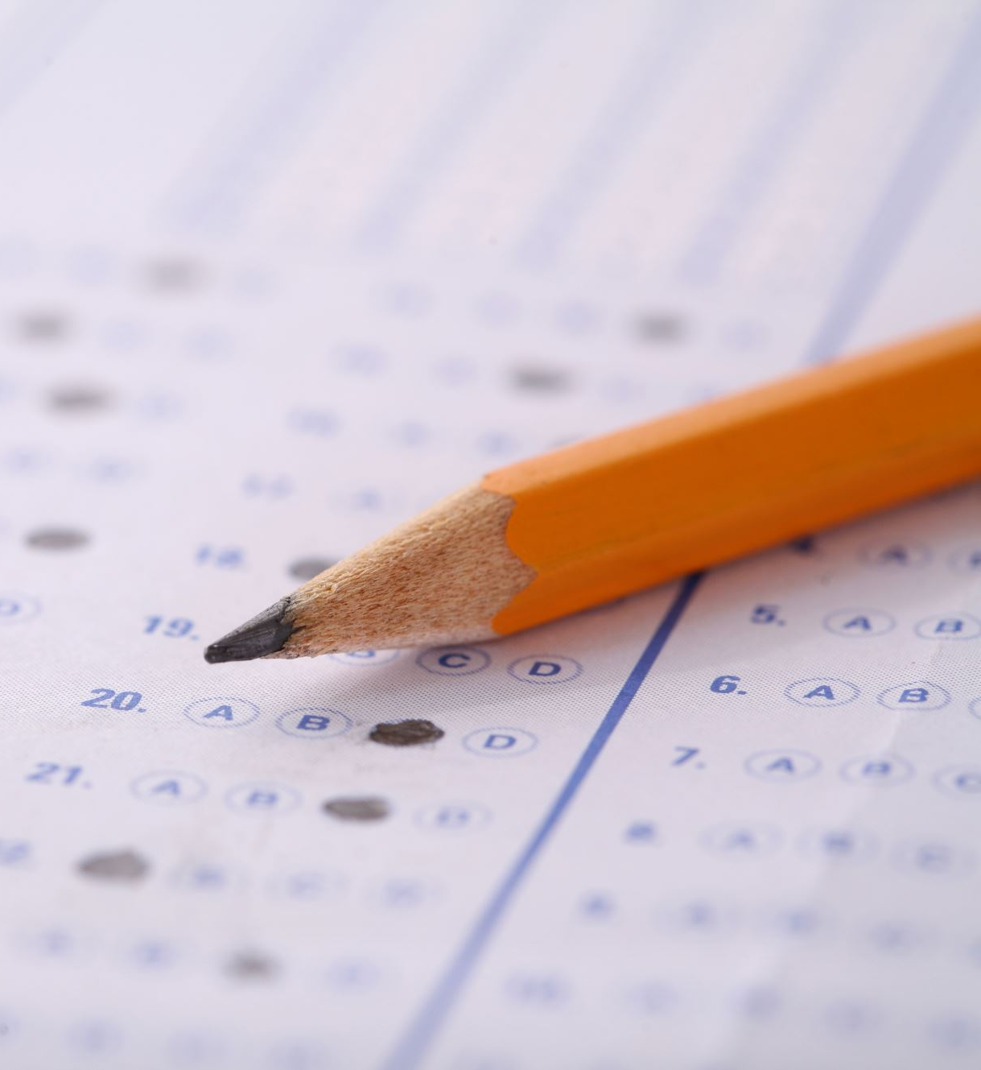

Voting Predictions
Brian Fitzpatrick
Isabelle Scrimsher

Slide 2
Our Goal
Predict who someone may vote for in 2024
Use ANES

Slide 3

Coding
Data cleaning
Logistic Regression
Optimization

Slide 4


Predicted Probabilities
Predicted probabilities used along with logistic regression to predict the variation in the target variable

